Slide 1

Modeling Depression
Daniel, Ashwin, Nupur, Jose, Sep

Slide 2

Depression – a Common Illness
264 Million People Diagnosed with Depression Worldwide
Close to 800 000 people die due to suicide every year. Suicide is the second leading cause of death in 15-29-year-olds.
Between 76% and 85% of people in low- and middle-income countries receive no treatment for their disorder

Slide 3
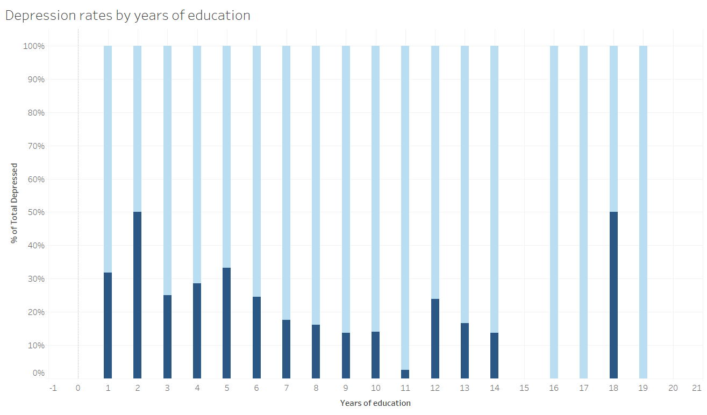
Data insights
Education

Slide 4
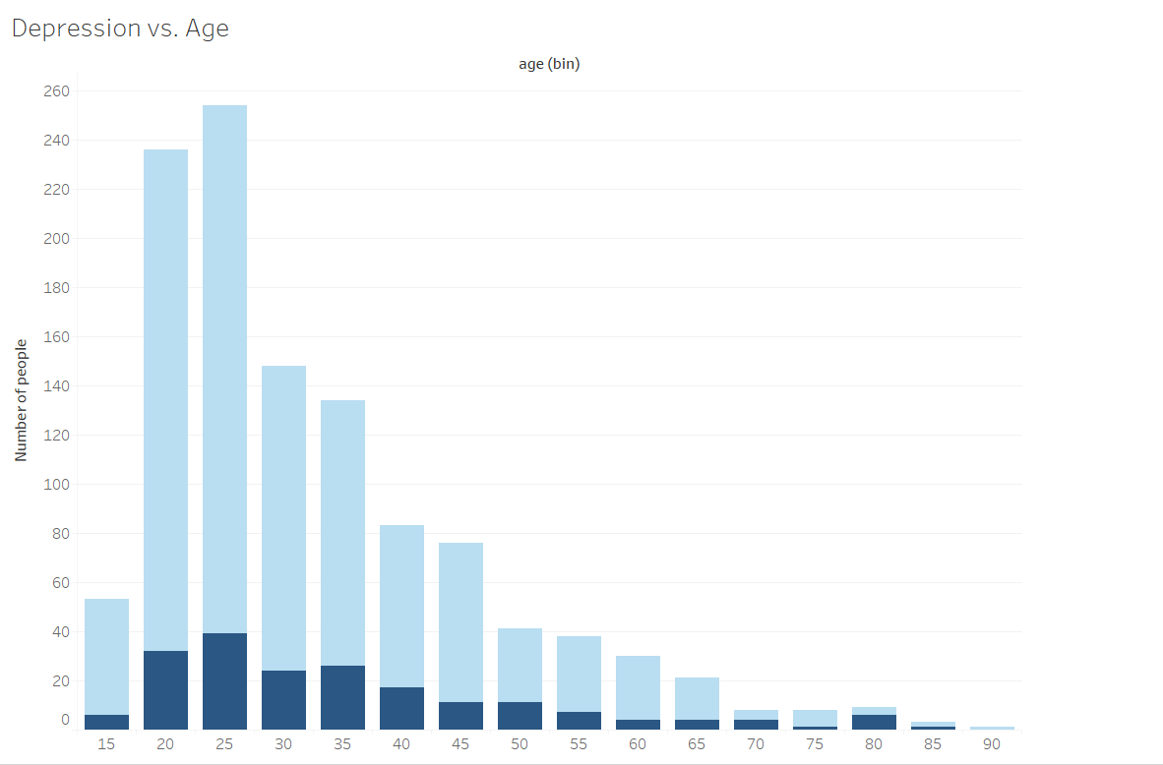
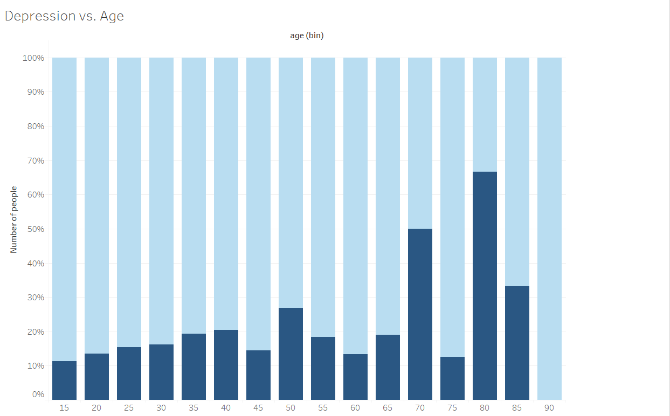
Data insights
Age

Slide 5
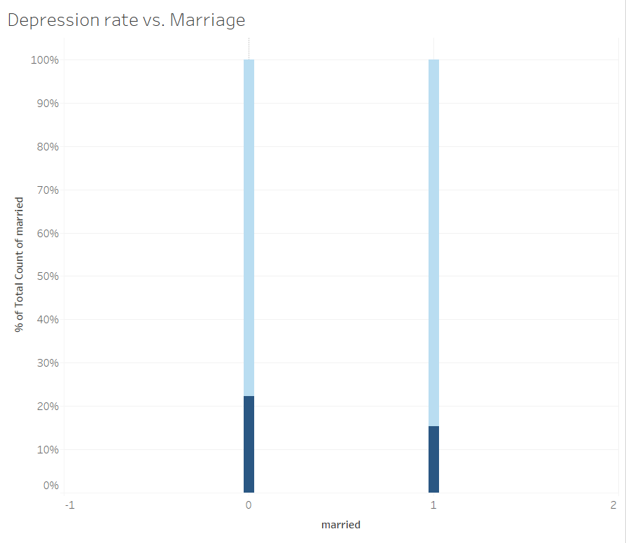
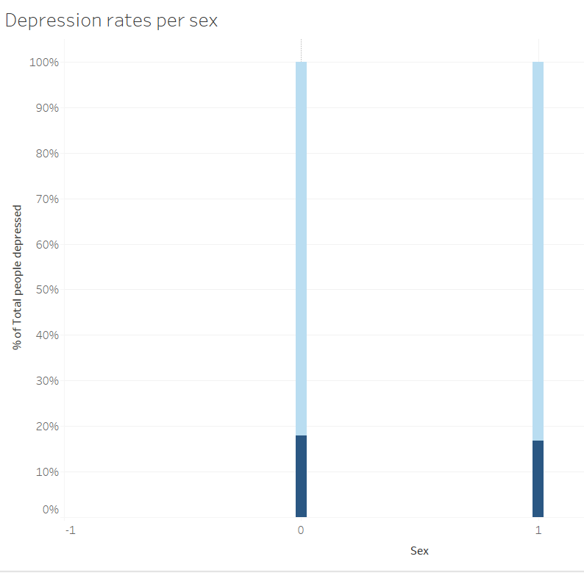
Data insights
Marriage
Sex

Slide 6
Model Selection
Logistic Regression
Support Vector Machines
Random Forrest
Decision Tree
Neural Network
Why these?
Problem type
Regression vs Classification
Probability vs Binary Category

Slide 7
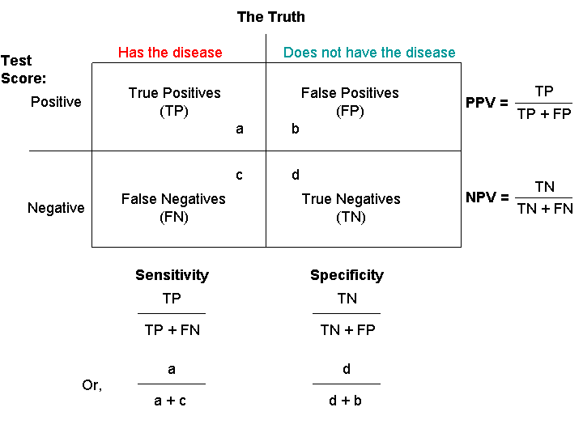
Statistical Measures
Confusion Matrix
Sensitivity
Specificity

Slide 8
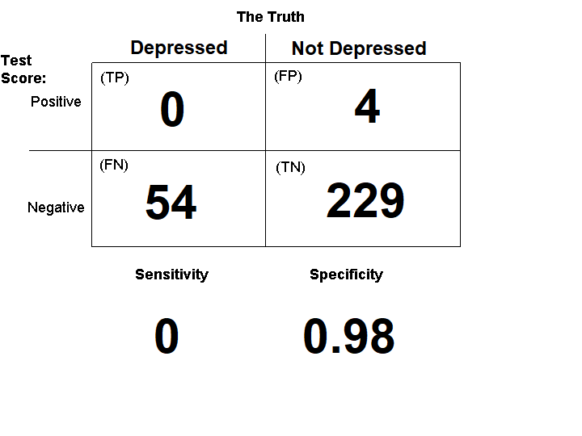
Logistic Regression
Simple
Coefficients
Odds Ratio
Many Features are a challenge
Training Score:0.84
Testing Score:0.80

Slide 9
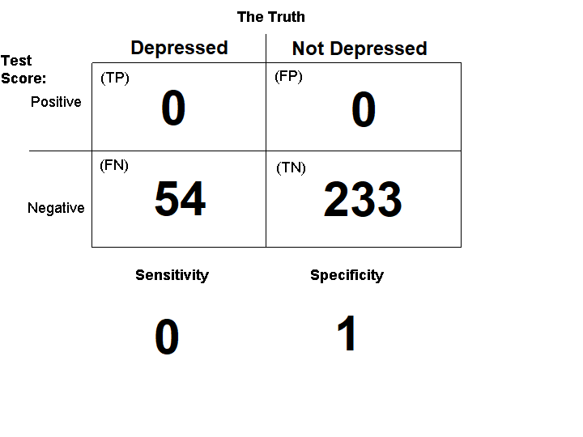
Support Vector Machine
Relatively Simple
Linear vs Nonlinear(polynomial kernel)
Largest hyperplane
Struggles with larger datasets
Training Score:0.84
Testing Score:0.81

Slide 10
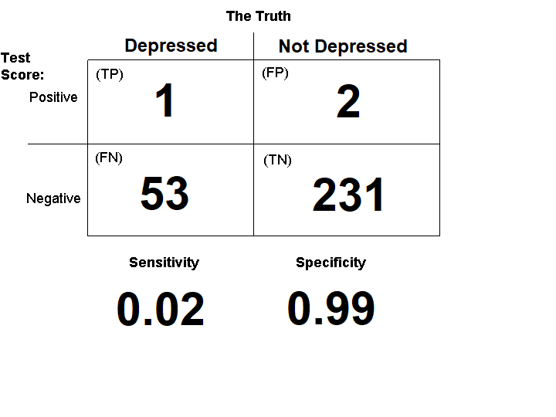
Random Forrest
Less likely to become overfit to data
Still intuitive
Training Score:0.98
Testing Score:0.70

Slide 11
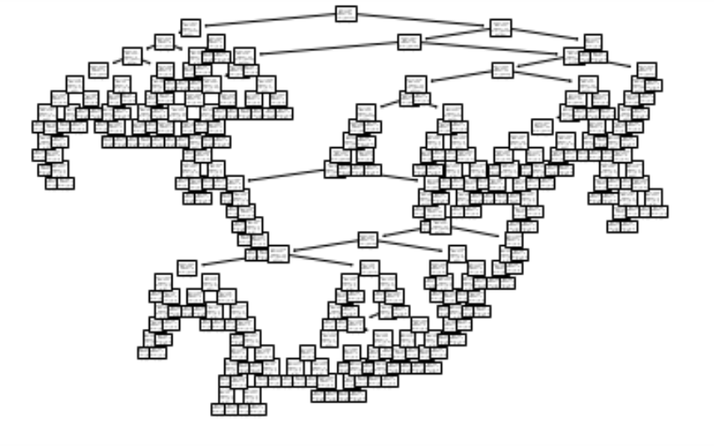
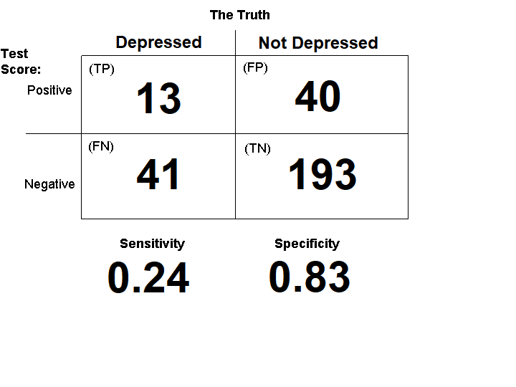
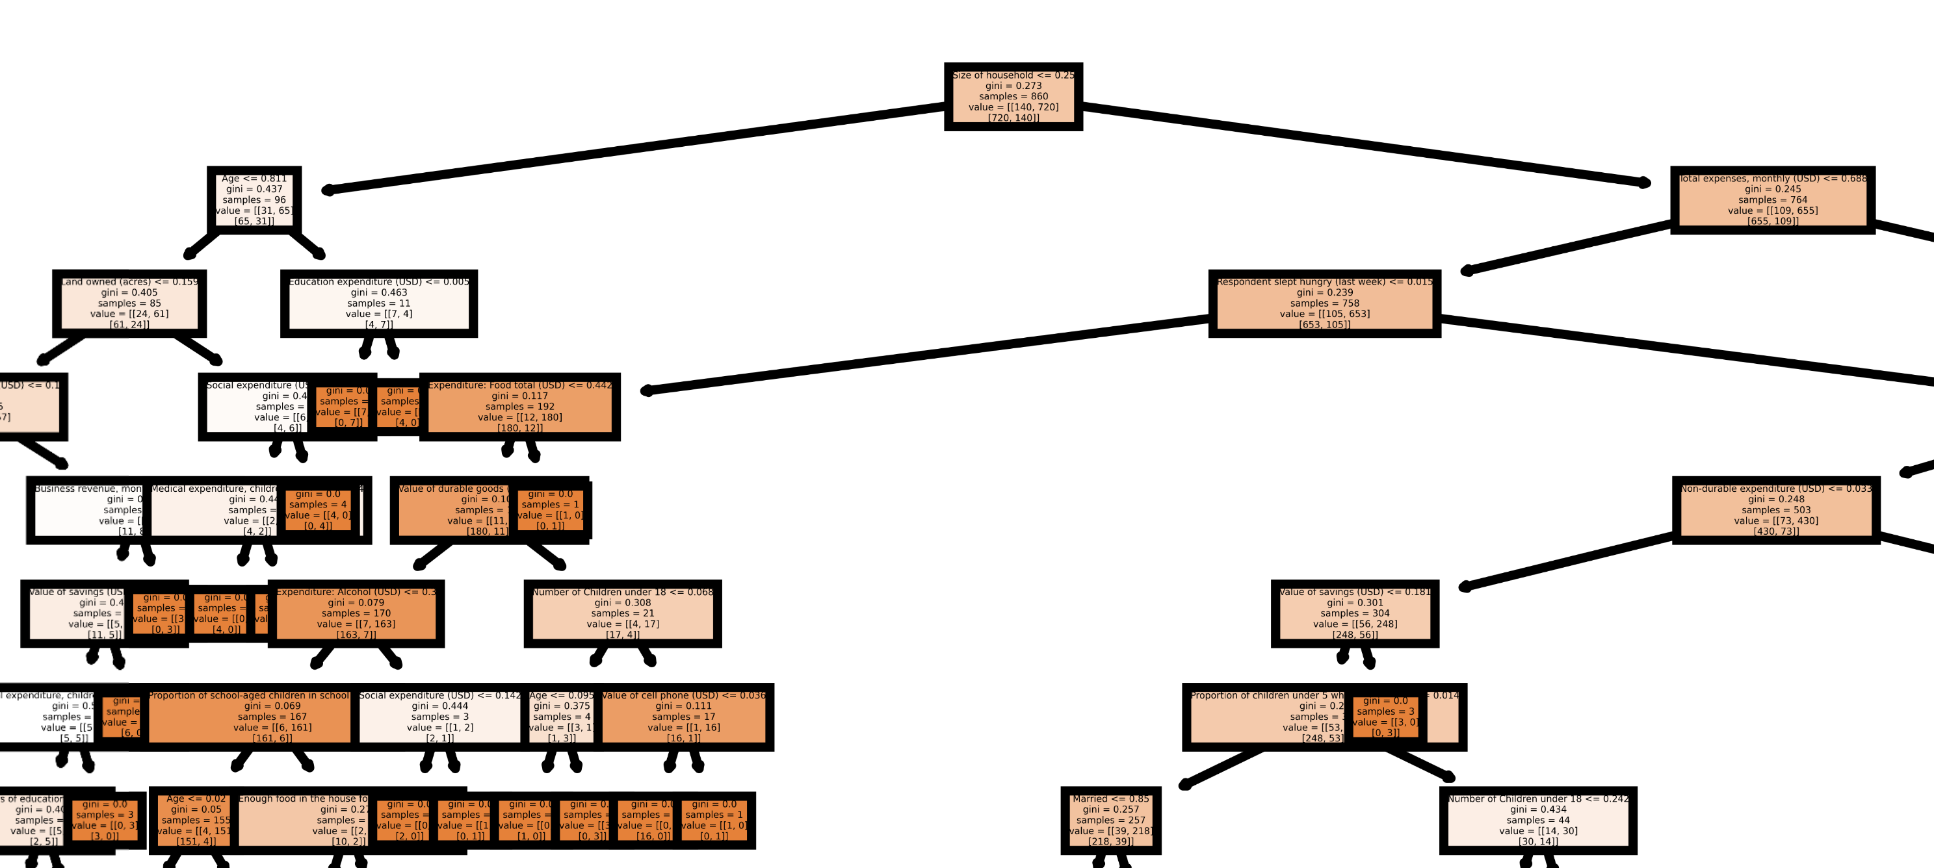
Decision Tree
Intuitive
Can handle many features
Training Score:0.99
Testing Score:0.80

Slide 12
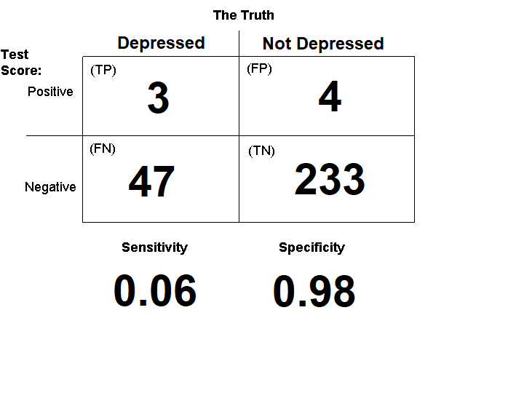
Neural Network
Can handle large datasets with multiple variables
Deep
Two hidden layers
Functions
RELU
ELU
Tanh
SoftMax
Sigmoid
Training Score:0.85
Testing Score:0.82

Slide 13
Front END

Slide 14
Limitations
Limitations of the Model
Depression may not be a binary disease
Limitations of the Dataset
Hard to find medical datasets
Our dataset for rural population in Kenya
Older dataset- from 60s
Better survey questions
Not enough data for each variable

